Slide 1
Week 4:
Cover Letters

Slide 2

Module Objectives
  Review format and content requirements for a professional cover letter
  Recognize areas in need of updating, and provide suggestions on how to improve marketing materials
  Create a professional targeted cover letter using Vmock
NEXT

Slide 3
What is a Cover Letter?
A one-page document that you submit as part of your job application (alongside your Resume or online application).
A cover letter is a supplement to your resume, not a replacement. Meaning, you don’t just repeat whatever is mentioned in your resume.

Slide 4
Cover Letter and it’s purpose
A short & concise introduction of yourself
Mention the job (or kind of job) you're applying for (or looking for); include the job number (#) if applicable
Let them know WHY you want to work there.
Show that your skills and experience match the skills and experience needed to do the job
Finish with a call to action (for example, asking for an interview or a meeting) and provide how they can contact you (email/cell)

Slide 5
Tips!
Length : Keep it short, concise and clear
  1 page Max (approx. 250-400 words)
Formatting: Consistent with Resume
  Use the same header (Name, Contact info) layout
  Use the same font and font size
Maximum (3-4) paragraphs
  Greeting : Dear (insert name of hiring manager), Avoid using gender specific greetings such as “Dear Sir”
  Opening Paragraph: What role are you applying for, and why you’re applying
  2nd/3rd Paragraph: Skills and Value you have to offer based on the job posting requirements
  Conclusion: Closing & Contact Info

Slide 6
Addressing your Cover Letter
If you know the name of the hiring manager, address it to them directly.
  For example: “Dear John Smith,”
If the hiring manager's name isn't available, include the company name and address at the top of your cover letter.
  Then, address the letter as "Dear Hiring Manager.”

Slide 7
*Optional : Cover Letter
Do you include a Cover Letter when it is optional?
Yes, it may increase your chances!
Attaching a cover letter will make your resume stand out and show that you're prepared to put in the extra effort.

Slide 8
Cover Letter Template
[Your HEADER (same as your Resume); Include your Name, Your Phone Number, Your Email Address, Your LinkedIn Profile URL]
[The date – the date you submit your resume]
[The company's name]
[Their mailing address]
[Greeting ],
[State your name and the role you're applying for. Then, provide a short overview of your strengths and your most significant accomplishments related to the role. Express your excitement and briefly explain how the role matches your career goals.]
[In the second paragraph, discuss your most recent professional role and give an overview of relevant past accomplishments. Explain the impact of your accomplishments, and use statistics to quantify your successes when possible.] [Use specific examples from previous professional experiences to explain what makes you uniquely qualified for the position.]
[Thank the employer for their time and consideration, and express your interest in continuing with the hiring process.]
[Closing statement],
[Signature]
[Your typed name & Contact information]

Slide 9
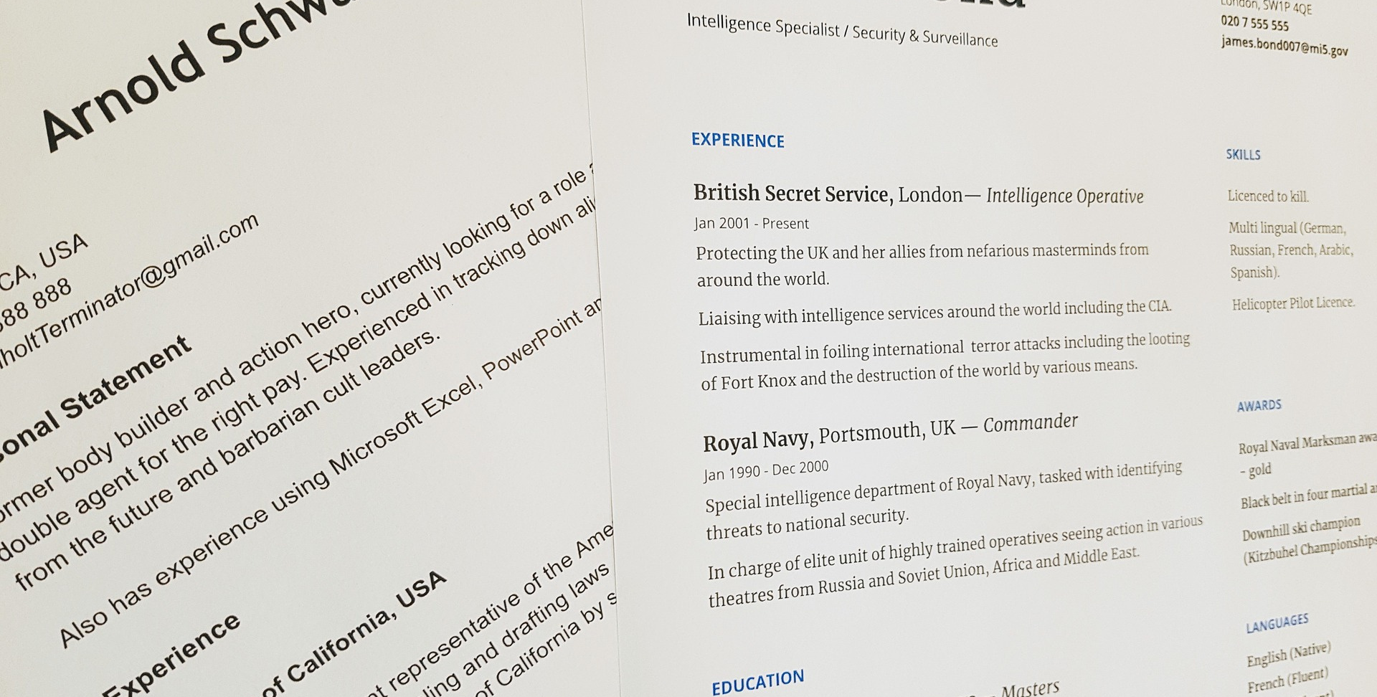
Cover Letter - Introduction Section
The purpose of your letter, what are you applying for?
Example: Please consider my application for the position of ______ advertised at _____ on ____date
OR
Please consider my application for any part-time positions that come available at _________
NEXT

Slide 10
Cover Letter - Education Section
What have you gained from post-secondary education that qualifies you related to the position?
Example:
Currently enrolled in ________ at Lambton College through which I have gained a solid working knowledge of.......
NEXT

Slide 11
Cover Letter - Experience & Skills Section
What specific experience and skills have you gained from work, volunteering, other activities that qualify you for the position?
Example:
While working as a Customer Service Representative at BMO I developed excellent interpersonal skills and was able to manage clients' problems and offer effective solutions........
NEXT

Slide 12
Cover Letter - Closing Section
Thank the reader, request interest in an interview and include contact information.
Example:
Thank you for reviewing my resume. I look forward to hearing from you to further discuss my qualifications at an interview. I can be reached at _______ or via email at ________.
NEXT

Slide 13
Anne Galindo
123-456-7890 | anne.smith@email.com
January 23, 2021
Company ABC
Toronto (ON)
Dear Hiring Manager,
I’m excited to be applying for the web developer position at [Company Name]. I’ve been programming websites and using CSS to create user-friendly experiences since I was in middle school, so it’s always been a passion of mine. I’ve also been intrigued by your company ever since it won Most Innovative at the National Web Development Awards two years ago. I strive to stay on the cutting-edge of web design and development, so when I saw this job posting, I knew I had to apply.
During my previous role at [Company Name], I built a website completely from scratch for a recently rebranded business, both ahead of schedule and within budget. I started by gathering requirements from my clients and holding a focus group to perform user research. My favorite part about web design is building a solution that impresses the client and meets the needs of users and customers. My new website was responsive, lightning-fast, and included the latest e-commerce features. After launch, I continued to lead optimization efforts. Through A/B testing, I improved the click-through rate by 10% and reduced the bounce rate on the website’s landing page by 35%. As your web developer, I would bring these skills to develop websites that exceed the expectations of clients and customers, and drive real business results.
One of the factors that really attracted me to this role is that [Company Name] values giving back to the community. In my spare time, I run free web development workshops for at-risk youths. In these workshops, I teach them the basics of HTML/CSS and JavaScript and serve as a mentor. As I grow in my career, applying my skills to help others and make an impact on the world becomes more important—I believe this role would give me that opportunity.
Thank you for your consideration and time. I’m looking forward to learning more details about the position and company.
Sincerely,
Anne Galindo

Slide 14
What NOT to include in your Cover Letter
Spelling or grammar mistakes
Don't restate your resume; focus on a few key accomplishments based on Job Posting
Don't use the same Cover Letter for every position (target each Cover Letter)
Don't lie
Don’t explain WHY you are looking for a job
Don't include your salary expectations or compensation requirements
Don't talk about irrelevant information for the job (i.e. Family, immigration, your hobbies, where you are from, why your last job didn't work out)

Slide 15

Proofread
Triple-check for accuracy
One typo could cost you an interview!

Slide 16
FINAL TAKE AWAYS
PoP – Power of Proofreading
Be consistent in your Formatting
  Font, Size of Font, indentations, bolding, etc.
Keep it short:
Accomplishments are KEY!
Target your Cover Letter to each job you apply for!!!

Slide 17
Time to Review your Cover Letter
Do you need to make any adjustments to your cover letter?
NEXT

Slide 18

Cover Letter and Resume Assignment (20%)

Slide 19
Cover Letter & Resume Assignment Outline & Marking Criteria (20%)
Objective: Update your cover letter and resume to ensure you are ready to stand out from the crowd!
Instructions: Find a job posting relevant to your study area. Create a cover letter and a resume to target that job posting, as if you were applying for that specific job.
Part 1: Cover letter
Write a cover letter that targets the specific job posting. Please use the content covered in this unit to create your cover letter.
Part 2: Resume
Use VMock (refer to instructions within the course) to create your updated and polished resume. A score and feedback will be provided to you in vMock. You can make updates and re-submit again through vMock to update your feedback and improve your resume and your score. Students have 8 attempts to create a resume that has a score of a minimum of 70%. Once you have obtained the 70% score, take a copy or a screen shot of the report, and add it to the Resume Dropbox with a copy of the resume you created.
Submission Instructions: Upload the job posting, cover letter, resume and a screen shot of your vMock resume final score to the specified Dropbox by the required deadline.

Slide 20
Cover Letter & Resume Assignment Outline & Marking Criteria (20%)
Marking Criteria: Cover Letter
Marking Criteria: Resume
Format:
Follows format outlined in class, creative and stands out
/2
Format:
Follows format outlined in class, creative and stands out
/4
Content:
3-4 paragraphs including (intro, education, experience & closing)
/3
Content:
Professional, well-developed skills statements, uses bullets/point form
/8
Targeted:
Accomplishment statements/proof of qualification
/3
Targeted:
Specific to job posting, highlighting transferrable skills
/4
Overall Appearance/Marketability:
Answers why should I hire you
/2
Overall Appearance/Marketability:
Answers why should I hire you, creative layout and polished look and feel
/4
Deductions:
Spelling/gramma concerns, fails to demonstrate uop-to-date
Deductions:
Spelling/gramma concerns, fails to demonstrate uop-to-date
/10
/20
Marking Criteria: vMock Score
vMock Score:
vMock Score is at least over 70%
TOTAL SCORE
/10
/40

Slide 21

vMock Cover Letter Module
NEXT

Slide 22

VMock, is a 24-7 online marketing material-review tool, that leverages data-science, machine learning, and natural language processing to provide instant personalized feedback on your resume based on criteria gathered from employers and global best practices.
https://www.vmock.com/video

Slide 23


Explore vMock
In-class Activity
35 min.

Slide 24

Explore vMock In-Class Activity
Take the remainder of today’s class time to explore vMock.
Play around with the features and explore!
Upload your current resume and read the feedback.

Slide 25
References
https://www.livecareer.com/questions/2502/what-is-the-difference-between-a-chronological-and-functional-resume
https://novoresume.com/career-blog/ats-resume

